Slide 1


HOW TO ACCESS MINTS DATA

Slide 2

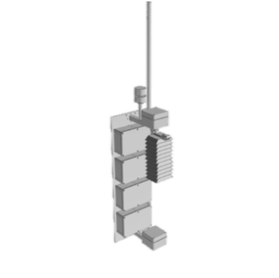
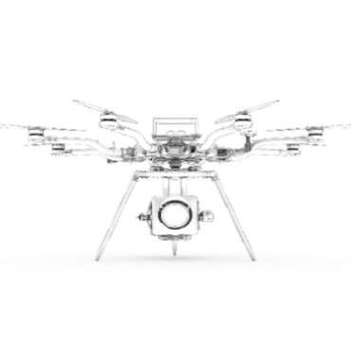
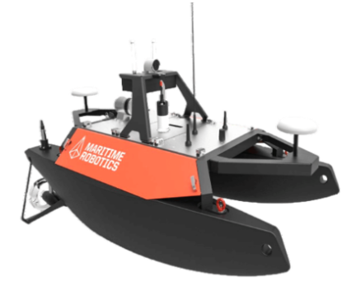
MINTS Lab
MINTS is a multidisciplinary platform developing intelligent sensing systems headquartered at the University of Texas at Dallas (UTD). The platform hosts experts from the UTD department of Physics as well as other academic branches within UTD. MINTS data is collected by different types of sentinels such as Ground observation monitors, Aerial survey and Robotic boat etc.
Access MINTS data:
Public Portal:
https://www.sharedairdfw.com/
Comprehensive Grafana Dashboards:
http://mdash.circ.utdallas.edu:3000

Slide 3
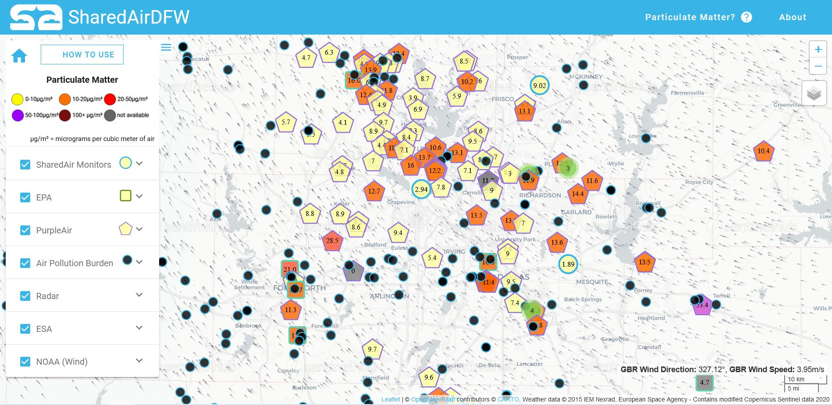
SharedAirDFW
Here is a sample view of the SharedAirDFW page. This page is essentially a map for locations of Particulate Matter (PM_{2.5}) ground monitors and accessing the PM_{2.5} data.
You can access the SharedAirDFW using https://www.sharedairdfw.com/
HOW TO USE
SHOW/HIDE PANEL
PARTICULATE MATTER
ABOUT
HOME
ZOOM IN/OUT
MAP STYLE
SHAREDAIR MONITORS
EPA
PURPLEAIR
AIR POLLUTION BURDEN
RADAR
ESA
NOAA (Wind)

Slide 4
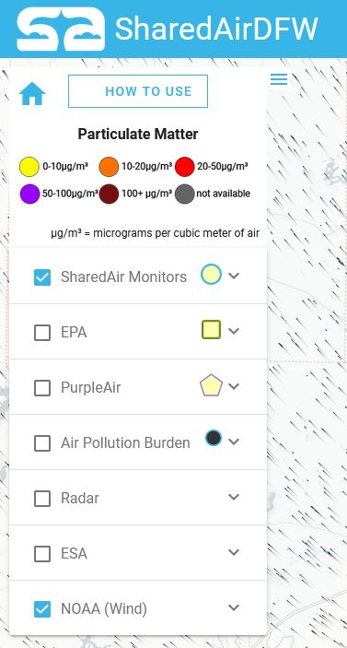
At top of the Control panel includes HOME, HOW TO USE and SHOW/HIDE PANEL buttons.
Color chart for different concentration range of Particulate Matter display right bellow the buttons
There are seven individual panels series bellow the Color chart.
Each panel has a check box and a drop-down menu.
By selecting check box make sensor location visible on the map (except NOAA (wind),).
By selecting check box of NOAA (wind) allows to display the wind vectors.
By hitting on drop-down menu of each panel shows more details and options available.

Slide 5
HOME |  | HOW TO USE
This takes you back to the default settings. It will display the location of the SharedAir monitors in the Carto Positron map style with wind vectors. |  | The HOW TO USE button pops up a brief instruction window. It provides instruction to see the real time data in each sensor, adding layers to the map and changing the map styles.
SHOW/HIDE PANEL |  | PARTICULATE MATTER
This button can be used to show or hide the Control panel. You can access the full map by hiding the Control panel by clicking on this button. |  | Clicking this button will pop up a new window with a brief description about Particulate Matter.
ABOUT |  | ZOOM IN/OUT
This button will open a new window and will give a brief description about the SharedAir monitors, funding, the developers of the sensors and the website. |  | There are two separate buttons: “+” and “-” , which allows you to zoom in and zoom out of the map area respectively.
MAP STYLE
There are four map styles that can be selected using this button. Once you get the mouse cursor on this icon, it expands with the map options: Carto Positron, Dark mode, Satellite and Street Maps.

Slide 6
SHAREDAIR MONITORS |  | EPA
SharedAir monitors are sensors made in the MINTS lab at UTD. Mainly PM_{2.5} concentration data is available in this site. Under the drop-down menu two options are available for averaging data: hourly average and 30 second average with the default being 30 second average. |  | PM_{2.5} data obtained from the EPA's Air Quality System (AQS) database collected by state, local, tribal, and federal air pollution control agencies from thousands of monitors around the nation. Only hourly averaged PM_{2.5} data is available on this site.
PURPLEAIR |  | AIR POLLUTION BURDEN
PurpleAir, a community system of PM low-cost sensors that are installed, controlled and maintained by members of the community. Only PM_{2.5} data averaged every 10 minutes can be obtained from this database. |  | Yearly estimated PM_{2.5} concentration where major air pollution are permitted.
RADAR |  | ESA
Weather data obtained from Radar. |  | Data of three gases can be monitored: NO₂, CO and CH₄, as provided by the ESA (European Space Agency).
NOAA (Wind)
Wind data obtained from NOAA (National Oceanic and Atmospheric Administration’s) database. Selecting this displays wind vectors on the map. Wind direction and speed at the location where the mouse cursor points is displayed on the bottom-right.

